Slide 1



Noida Institute of Engineering and Technology, Greater Noida
MATRICES
Unit: 1
MATHEMATICS – 1 (KAS – 103)
Rajnish Kumar Pandey
Affiliation from AKTU, Lucknow
Mathematics Department
B Tech 1st Sem

Slide 2
Content of Matrix
Introduction of Matrix
Types of Matrices
Inverse of Matrix
Rank of Matrix
System of Linear Equations
Vectors Dependence and Independence
Eigen values and Eigen vectors
Diagonalisation of a Matrix
Complex of Matrix
Elementary Transformations

Slide 3
Course Objective
Pre- requisites (if any) Knowledge of Intermediate Mathematics of UP Board or equivalent Board. Course Objectives: The objective of this course is to familiarize the graduate engineers with techniques in calculus, multivariate analysis, vector calculus and linear algebra. It aims to equip the students with standard concepts and tools from intermediate to advanced level that will enable them to tackle more advanced level of mathematics and applications that they would find useful in their disciplines. The students will learn: To apply the knowledge of differential calculus in the field of engineering. To deal with functions of several variables that are essential in optimizing the results of real life problems. Multiple integral tools to deal with engineering problems involving centre of gravity, volume etc. To deal with vector calculus that is required in different branches of Engineering to graduate engineers. The essential tools of matrices and linear algebra, eigen values and diagonalization in a comprehensive manner are required.

Slide 4
Unit Objective
The objective of this course is to familiarize the graduate engineers with techniques in linear algebra. It aims to equip the students with standard concepts and tools from intermediate to advanced level that will enable them to tackle more advanced level of mathematics and applications that they would find useful in their disciplines.
The students will learn the essential tools of matrices and linear algebra, eigen values and diagonalization in a comprehensive manner are required.

Slide 5
Course Outcomes 2020-21 (B. Tech. – 1st Sem)
Course Name: Mathematics-I (KAS 103)
CO1 | Apply the concept of matrices to solve linear simultaneous equations
CO2 | Apply the concept of successive differentiation and partial differentiation to solve problems of Leibnitz theorems and total derivatives .
CO3 | Apply partial differentiation for evaluating maxima, minima, Taylor’s series and Jacobians.
CO4 | llustrate multiple integral to find area, volume, centre of mass and centre of gravity.
CO5 | Demonstrate the basic concept of Profit, Loss, Number & Series, Coding & decoding.

Slide 6
Program Outcomes (POs)
Engineering knowledge: Apply the knowledge of mathematics, science, engineering fundamentals, and an engineering specialization to the solution of complex engineering problems.
2. Problem analysis: Identify, formulate, review research literature, and analyze complex engineering problems reaching substantiated conclusions using first principles of mathematics, natural sciences, and engineering sciences.
3. Design/development of solutions: Design solutions for complex engineering problems and design system components or processes that meet the specified needs with appropriate consideration for the public health and safety, and the cultural, societal, and environmental considerations.
4. Conduct investigations of complex problems: Use research-based knowledge and research methods including design of experiments, analysis and interpretation of data, and synthesis of the information to provide valid conclusions.

Slide 7
1. Engineering knowledge: Apply the knowledge of mathematics, science, engineering fundamentals, and an engineering specialization to the solution of complex engineering problems. 2. Problem analysis: Identify, formulate, review research literature, and analyze complex engineering problems reaching substantiated conclusions using first principles of mathematics, natural sciences, and engineering sciences. 3. Design/development of solutions: Design solutions for complex engineering problems and design system components or processes that meet the specified needs with appropriate consideration for the public health and safety, and the cultural, societal, and environmental considerations. 4. Conduct investigations of complex problems: Use research-based knowledge and research methods including design of experiments, analysis and interpretation of data, and synthesis of the information to provide valid conclusions. 5. Modern tool usage: Create, select, and apply appropriate techniques, resources, and modern engineering and IT tools including prediction and modeling to complex engineering activities with an understanding of the limitations. 6. The engineer and society: Apply reasoning informed by the contextual knowledge to assess societal, health, safety, legal and cultural issues and the consequent responsibilities relevant to the professional engineering practice.
Program Outcomes (POs)
5. Modern tool usage: Create, select, and apply appropriate techniques, resources, and modern engineering and IT tools including prediction and modeling to complex engineering activities with an understanding of the limitations.
6. The engineer and society: Apply reasoning informed by the contextual knowledge to assess societal, health, safety, legal and cultural issues and the consequent responsibilities relevant to the professional engineering practice.
7. Environment and sustainability: Understand the impact of the
professional engineering solutions in societal and environmental
contexts, and demonstrate the knowledge of, and need for sustainable
development.
8. Ethics: Apply ethical principles and commit to professional ethics and
responsibilities and norms of the engineering practice.

Slide 8
Program Outcomes (POs)
9. Individual and team work:Function effectively as an individual, and as
a member or leader in diverse teams, and in multidisciplinary settings.
10.Communication: Communicate effectively on complex engineering
activities with the engineering community and with society at large,
such as, being able to comprehend and write effective reports and
design documentation, make effective presentations, and give and
receive clear instructions.
11.Project management and finance: Demonstrate knowledge and
understanding of the engineering and management principles and
apply these to one’s own work, as a member and leader in a team,
to manage projects and in multidisciplinary environments.
12. Life-long learning: Recognize the need for, and have the preparation
and ability to engage in independent and life-long learning in the
broadest context of technological change.

Slide 9
CO-PO Mapping 2020-21 (B. Tech. – 1st Sem)
Course Name: Mathematics-I (KAS 103)
CO | PO-1 | PO-2 | PO-3 | PO-4 | PO-5 | PO-6 | PO-7 | PO-8 | PO-9 | PO-10 | PO-11 | PO-12
CO1 | 3 | 2 | 1 | 1 | 3 | 2 | - | - | - | 2 | 2 | 3
CO2 | 3 | 3 | 2 | 3 | 3 | - | - | - | - | 2 | 3 | 3
CO3 | 3 | 2 | 3 | 3 | 3 | 2 | - | - | - | 2 | 3 | 3
CO4 | 3 | 2 | 3 | 3 | 2 | 2 | - | - | - | 2 | 2 | 3
CO5 | 1 | 1 | 1 | 1 | 1 | - | - | - | - | 2 | - | 3
Mean | 2.6 | 2 | 2 | 2.2 | 2.4 | 2.0 | - | - | - | 2 | 2.5 | 3

Slide 10
Prerequisite and Recap
Need basic knowledge of addition and multiplication of matrices.
Need basic knowledge of Determinant.
Need basic knowledge of factorization of equations.

Slide 11
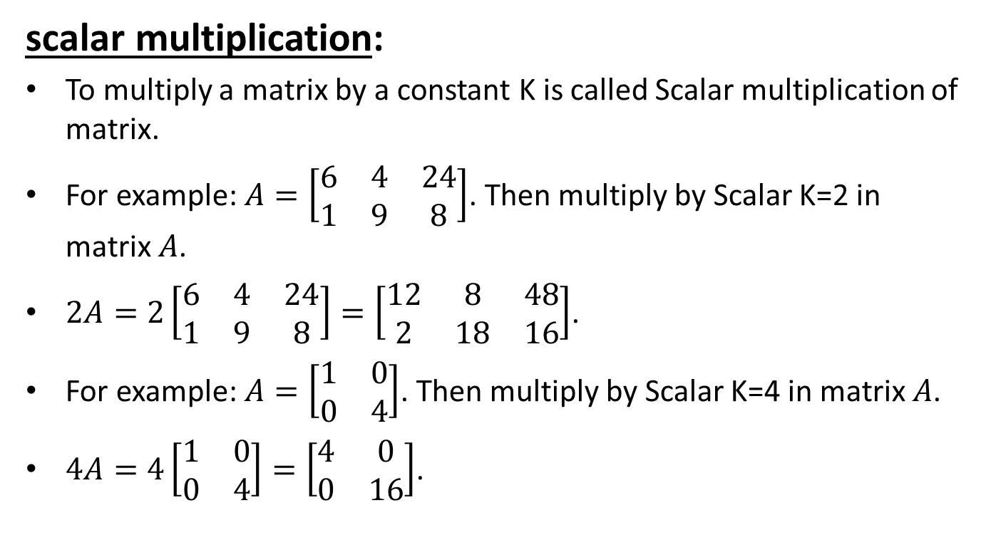
Recap of properties of Matrix

Slide 12
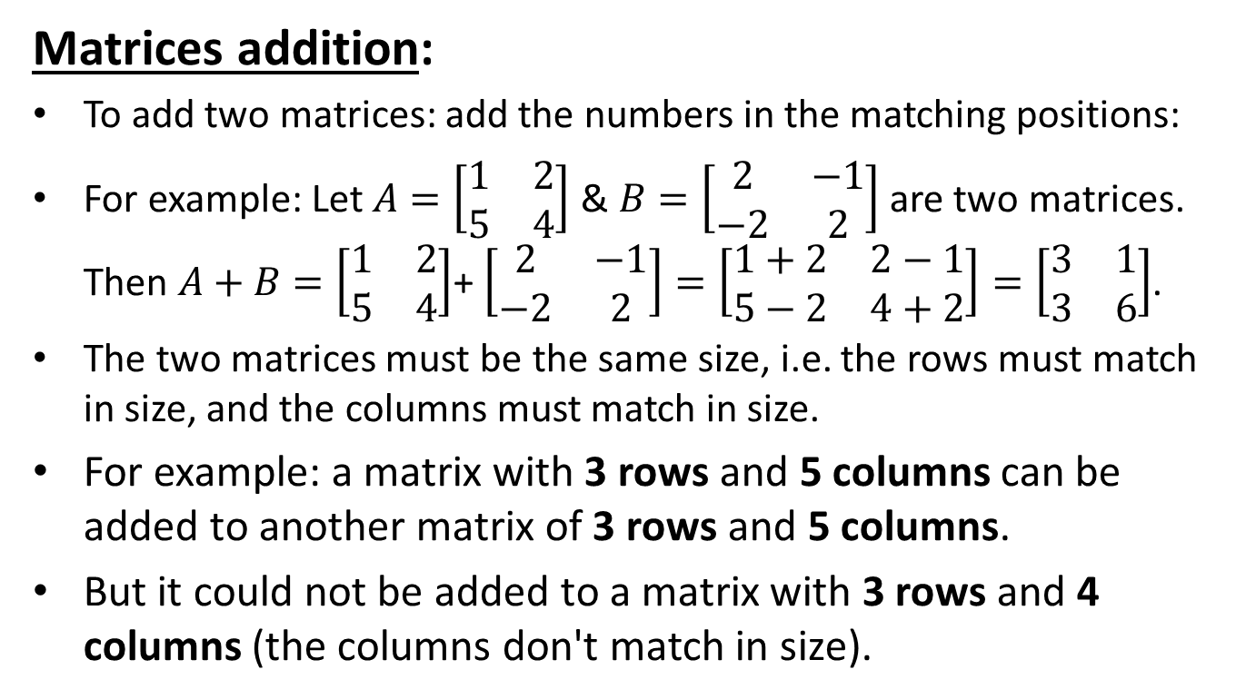
Recap of Matrix addition

Slide 13
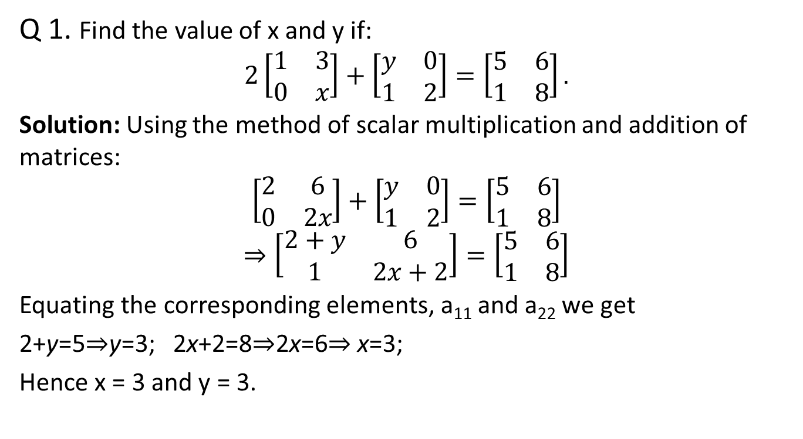
Recap of Matrix addition

Slide 14
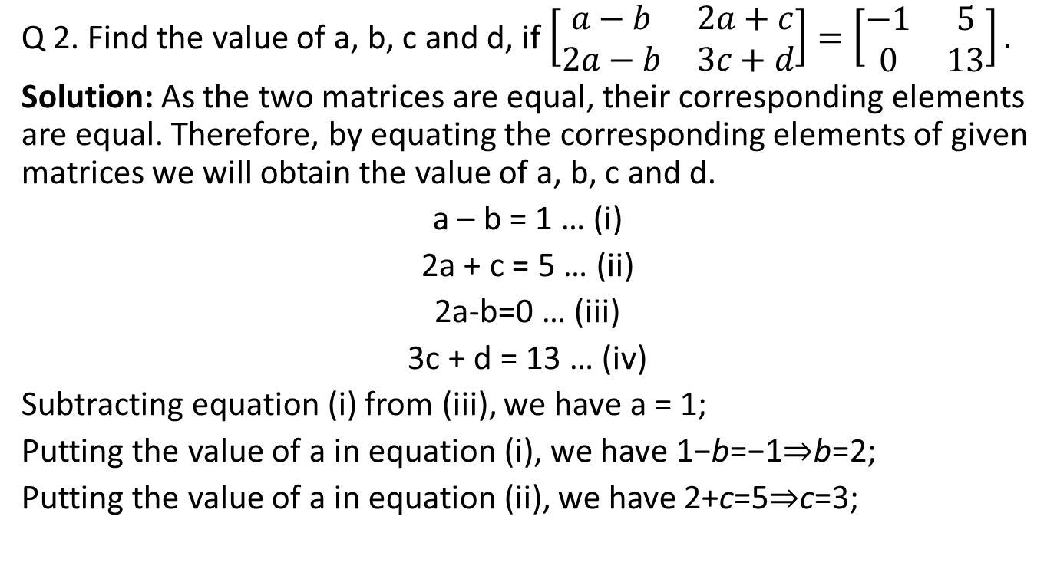
Recap of Matrix addition
Putting the value of c in equation (iv), 9 + d =13 ⇒ d=4
Hence a=1, b=2, c=3, d=4.

Slide 15
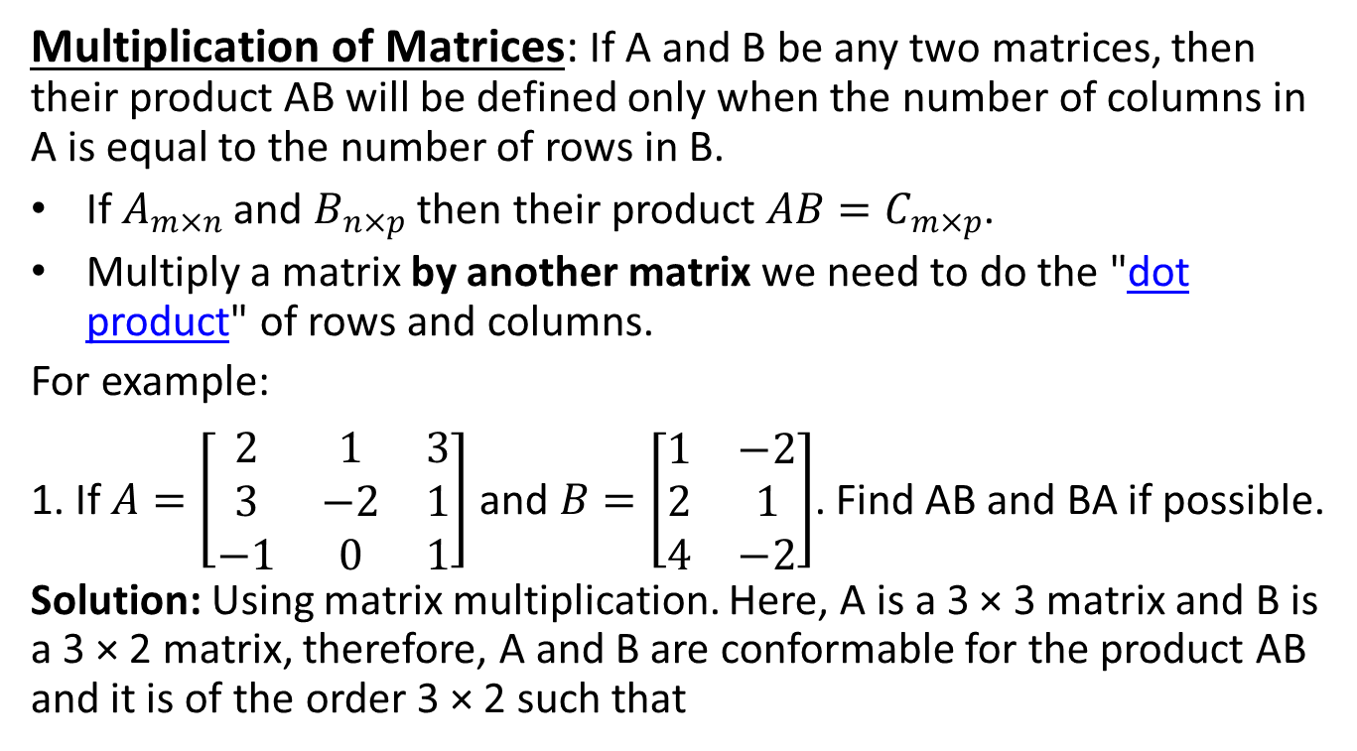
Recap of Matrix Multiplication

Slide 16
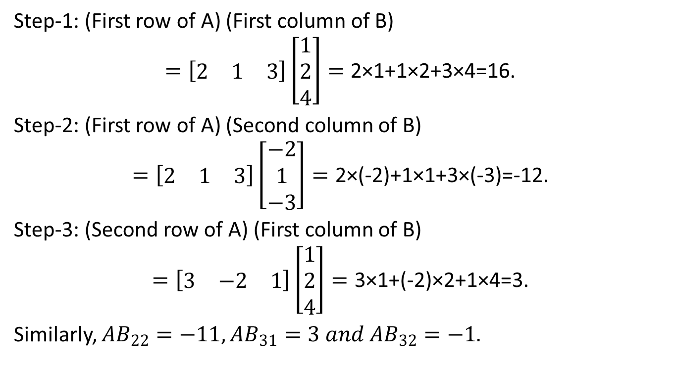
Recap of Matrix Multiplication

Slide 17
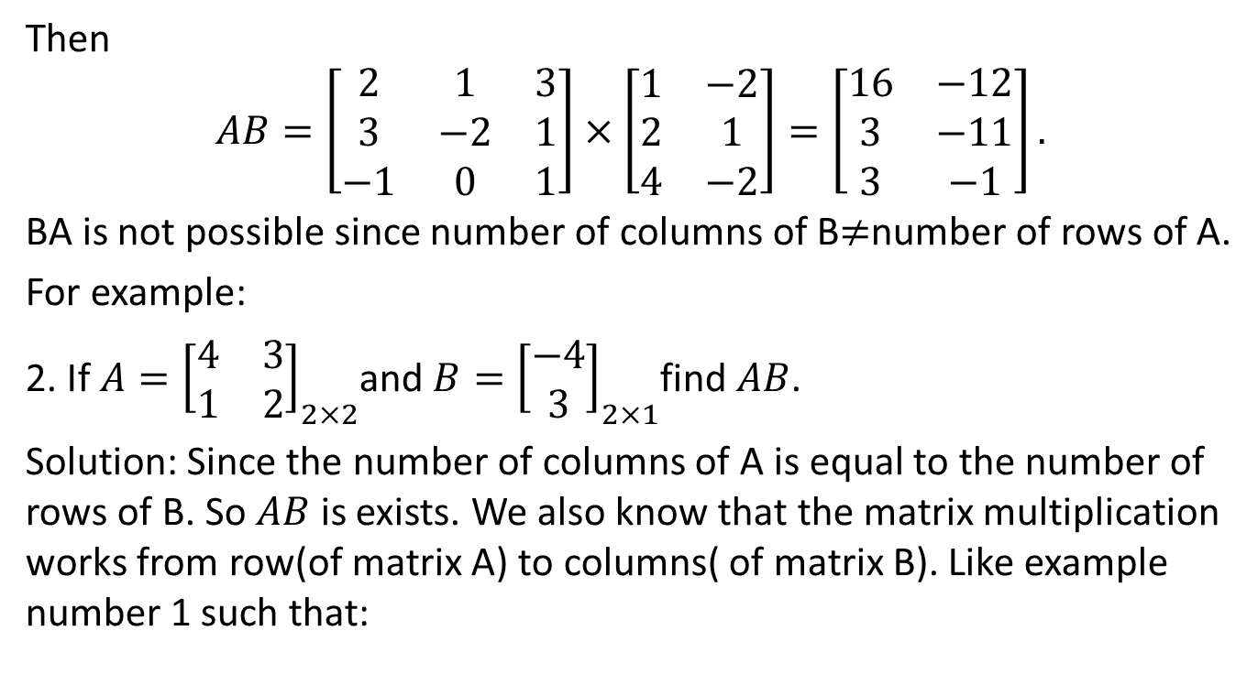
Recap of Matrix Multiplication

Slide 18
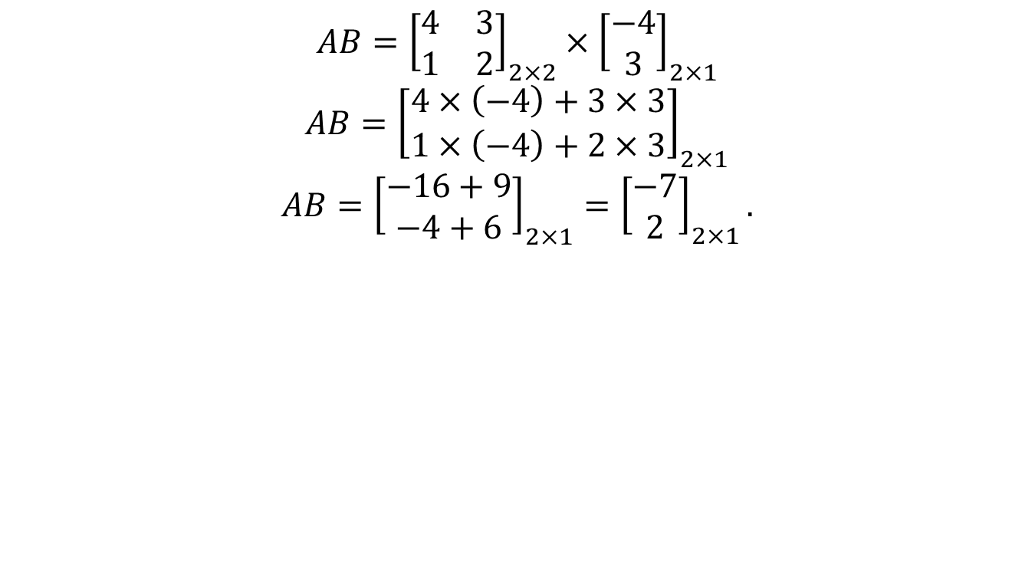
Recap of Matrix Multiplication

Slide 19
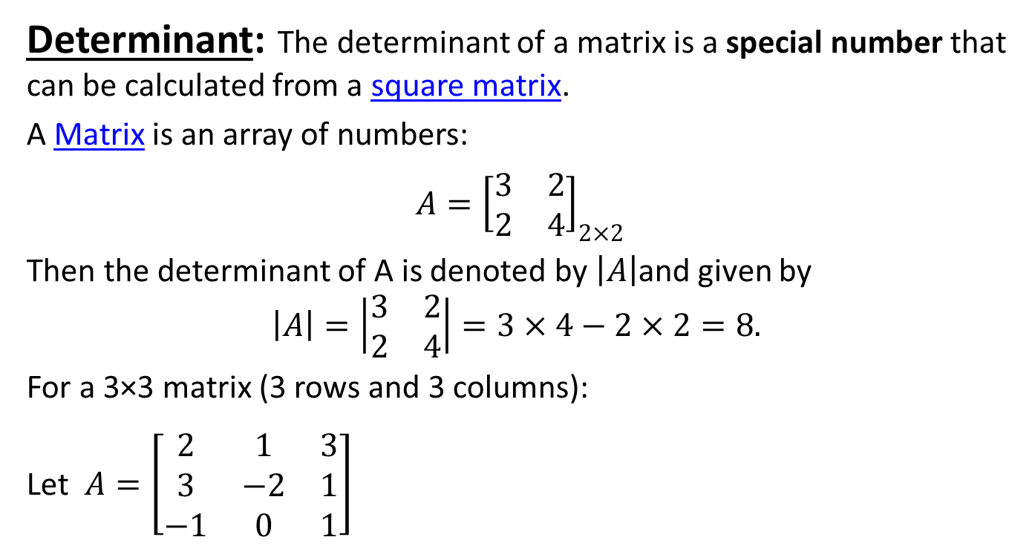
Recap of Determinant

Slide 20
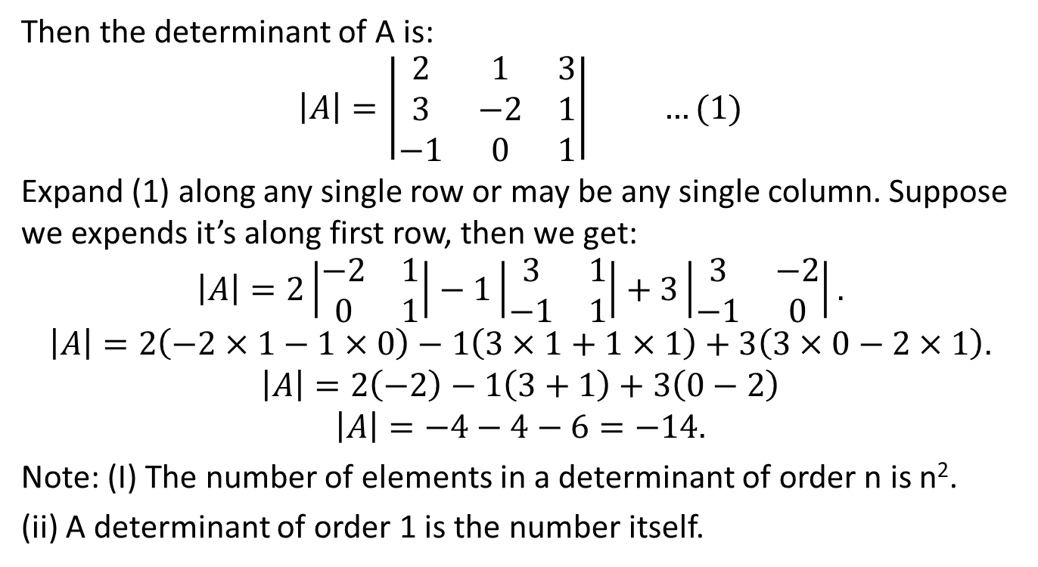
Recap of Determinant

Slide 21
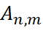
INTRODUCTION OF MATRIX (CO.1)
Definition
A matrix is a rectangular array of elements arranged in horizontal and vertical columns.
Where represent the ‘n’ rows and ‘m’ columns in a matrix now we can say the order of matrix is ‘nm’.

Slide 22
APPLICATIONS OF MATRICES (CO.1)
Applications of matrices are found in most scientific fields. In every branch of physics, including classical mechanics, optics, electromagnetism, quantum mechanics, and quantum electrodynamics, they are used to study physical phenomena, such as the motion of rigid bodies.
Matrices are also used for plotting graphs, statistics and also to do scientific studies and research in almost different fields. Matrices are also used in representing the real world data's like the population of people, infant mortality rate, etc. They are best representation methods for plotting surveys.

Slide 23
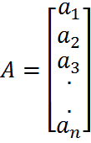
TYPES OF MATRICES (CO.1)
Square Matrix: Number of rows equal to number of columns
Here order of square matrix is ‘n’.
Column Matrix : Number of columns are one and numbers of rows
are more than one . Here the order of matrix is n×1.

Slide 24
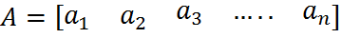
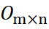
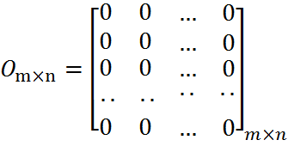
TYPES OF MATRICES (CO.1)
.
Row Matrix: Number of rows are n and numbers of columns are more than one. e.g. like
, here the order of matrix is 1×n.
Null Matrix: A matrix in which each elements is zero and null matrix of order m×n is denoted by .

Slide 25
TYPES OF MATRICES (CO.1)
Diagonal Matrix: A square matrix in which all non-diagonal
elements are zero.
Unit Matrix or Identity Matrix: A square matrix in which all
non-diagonal elements are zero and all diagonal elements are
unity (i.e. 1).

Slide 26
TYPES OF MATRICES (CO.1)
Triangular Matrices - I
Lower Triangular Matrix: A square matrix in which all the elements above the principal diagonal are zero.

Slide 27
TYPES OF MATRICES (CO.1)
Triangular Matrices - II
Upper Triangular Matrix: A square matrix in which all the elements below the principal diagonal are zero.

Slide 28
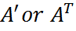
TYPES OF MATRICES (CO.1)
Matrix transpose: A matrix obtained from A by changing its row
into columns and columns into rows is called the transpose of A
and is denoted by . Like .
Symmetric Matrix: If conjugate transpose of A is equal to given
matrix A then matrix is called symmetric matrix. Like
Skew Symmetric Matrix: If conjugate transpose of A is equal to given matrix A then matrix is called symmetric matrix.
Singular Matrix: If the determinant value of a matrix A is equal to zero then matrix A is called singular matrix otherwise non-singular matrix.

Slide 29
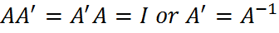
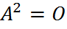
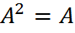
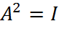
TYPES OF MATRICES (CO.1)
Orthogonal Matrix: A square matrix A is called an orthogonal matrix
if . .
Nilpotent Matrix: A square matrix A is called an nilpotent matrix if
Idempotent Matrix: A square matrix A is called an Idempotent matrix if
Involutary Matrix: A square matrix A is called an Idempotent matrix
if

Slide 30

TYPES OF MATRICES (CO.1)
Explain Square matrix.
What is Identity matrix or Unity matrix?
Explain the triangular form of matrix.
What is Idempotent matrix?
Explain Orthogonal matrix.

Slide 31
Inverse of matrix by E-Operations (CO.1)
Elementary row operations
Let A is a given matrix and let
Here denotes the 1st , 2nd ,… m^{th} rows.
The first nonzero element in a row
is called the
leading nonzero
element.
A row with all zeros is called a zero row.
A zero row has no leading nonzero element.
The following operations on A are called the elementary row operations:

Slide 32
Inverse of matrix by E-Operations (CO.1)
Matrices A and B are said to be row equivalent , written A~B, if matrix B can be obtained from matrix A by using elementary row operations.
The Inverse Of a Matrix: If
where is called the inverse of A.
Inverse of matrix by E-Operations or Transformations (Gauss-Jordan Method)
The elementary row transformations which reduce a square matrix A to the unit matrix, when applied to the unit matrix, given the inverse matrix .

Slide 33
Course objective of Inverse of matrix (CO.1)
Apply the formal definition of an inverse, and its algebraic properties, to solve and analyze linear systems.

Slide 34
Inverse of matrix by E-Operations (CO.1)
Solution: Let A = I A, Where I represent the identity matrix.

Slide 35
Inverse of matrix by E-Operations (CO.1)

Slide 36
Inverse of matrix by E-Operations (CO.1)

Slide 37
Inverse of matrix by E-Operations (CO.1)
FAQ
Prob. Find the inverse of the following matrices by using elementary row or column transformations:
Answers:

Slide 38
Inverse of matrix by E-Operations (CO.1)
What is Elementary Transformations or Operations?
Inverse of matrix is always unique. True/False
What is Gauss-Jordan Method?

Slide 39
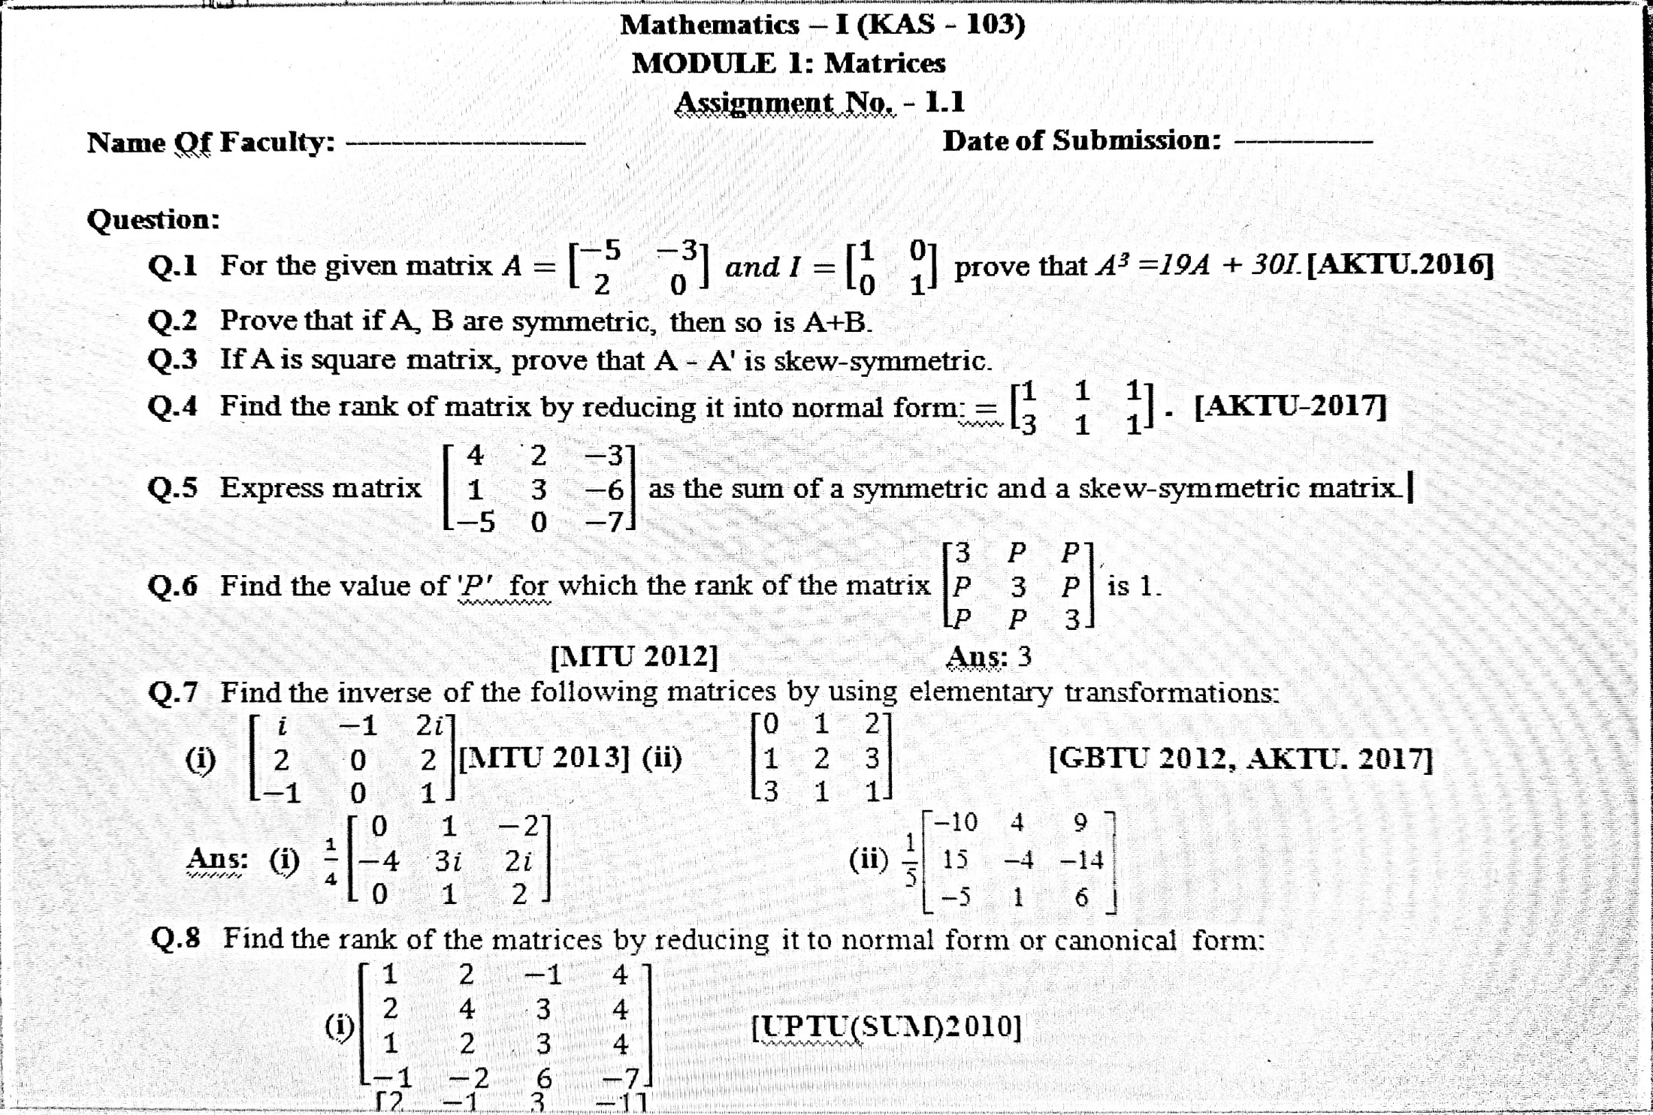
Assignment OF Inverse of matrix (CO.1)

Slide 40
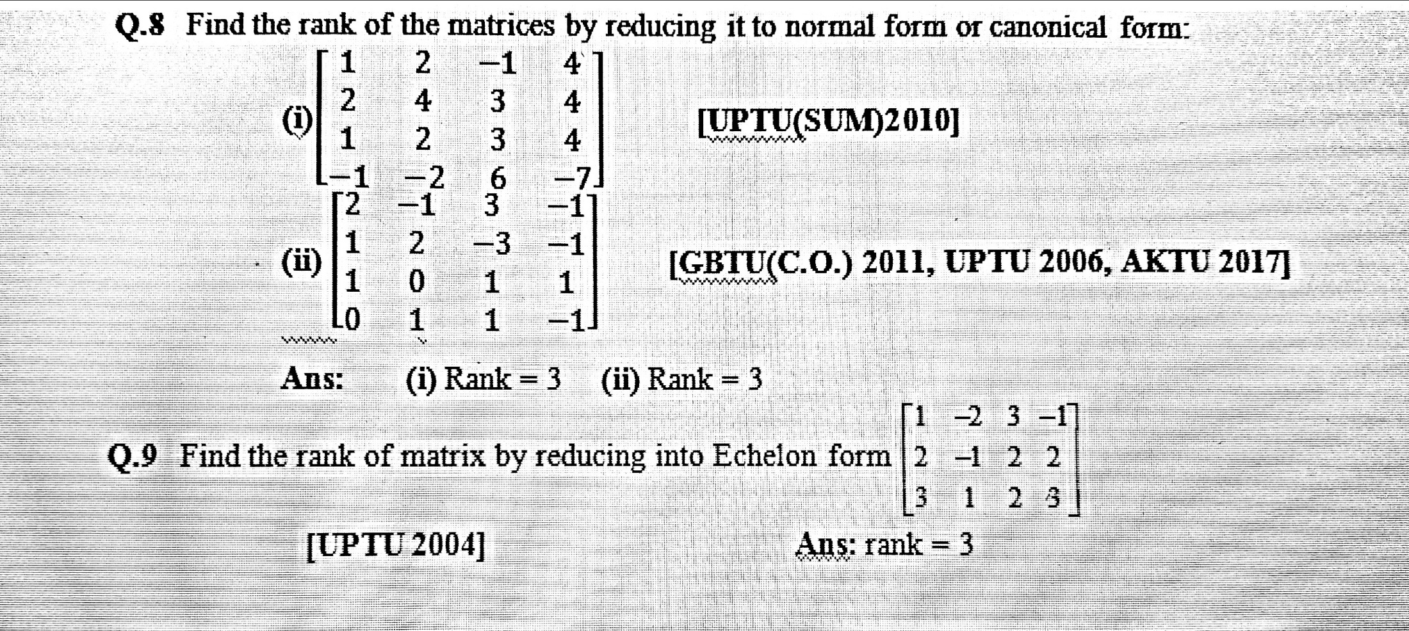
Assignment OF Inverse of matrix (CO.1)

Slide 41
Rank of a matrix (CO. 1)
Rank of a matrix
A matrix ‘A’ is said to be of rank r if
It has atleast one non-zero minor of order ‘r’.
All the minors of order (r+1) or higher than ‘r’ are zero.
Symbolically, rank of A = r is written as ρ(A) = r.
Method of finding Rank
Echelon form method
Normal Form Or Canonical Form method

Slide 42
Topic objective of Rank of matrix (CO. 1)
The rank of a matrix is of major importance. It is closely connected to
the nullity of the matrix (which is the dimension of the solution space
of the equation Ax=0), via the Dimension Theorem.

Slide 43
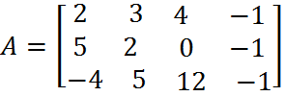
Rank of a matrix (CO. 1)
Echelon Form Method
Number of non – zero rows in an echelon form of matrices is called rank of a matrix.
A matrix ‘A’ is called an echelon form matrix if the following two conditions hold:
All zero rows, if any , are on the bottom of the matrix.
Each leading non - zero entry is to the right of the leading non - zero entry in the preceding row.
Prob. Find the rank of matrix by reducing into echelon form of the matrix

Slide 44
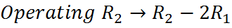
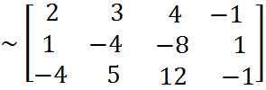
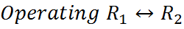
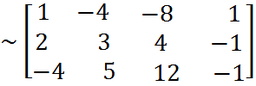
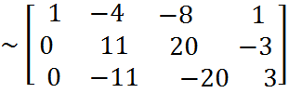
Rank of a matrix (CO. 1)
Solution: Here

Slide 45
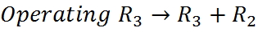
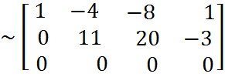
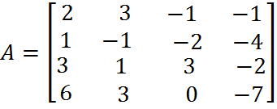
Rank of a matrix (CO. 1)
Prob. Use elementary transformations to reduce the following matrix A to triangular form and hence find the rank of A.
Which is Echelon form.

Slide 46
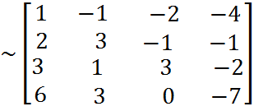
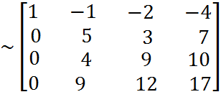
Rank of a matrix (CO. 1)
Solution: Here

Slide 47
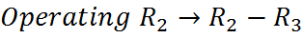
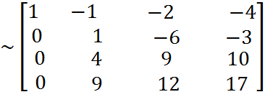
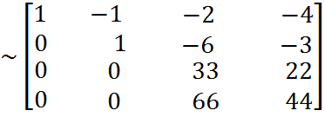
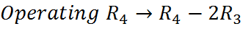
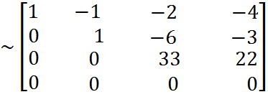
Rank of a matrix (CO. 1)
Which is upper triangular form.

Slide 48
Rank of a matrix (CO. 1)
FAQ
Prob. Find the rank of the following matrices by using elementary row transformations.

Slide 49
Rank of a matrix (CO. 1)
Normal Form Or Canonical Form
Normal form of a matrix A of rank r is one of the forms, where is an identity matrix of order r. By the application of both row and column transformation a matrix of rank r can be reduced to following normal form:

Slide 50
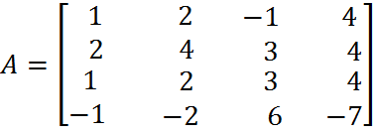
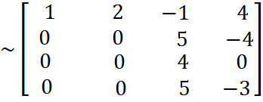
Rank of a matrix (CO. 1)
Prob. Use elementary transformations to reduce the following matrix
‘A’ to normal form and hence find the rank of A.
Solution: Here

Slide 51
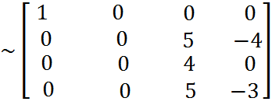
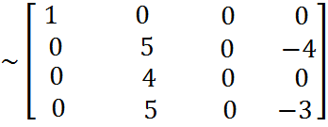
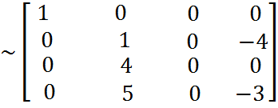
Rank of a matrix (CO. 1)

Slide 52
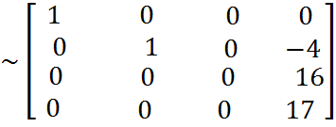
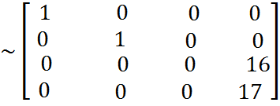
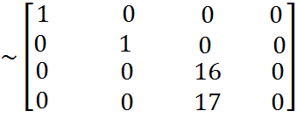
Rank of a matrix (CO. 1)

Slide 53
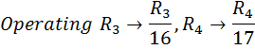
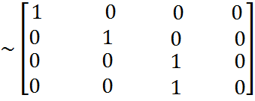
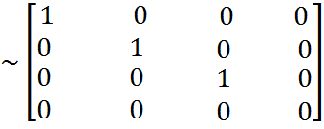
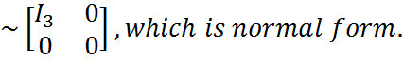
Rank of a matrix (CO. 1)

Slide 54





Rank of a matrix (CO. 1)
Prob. Determined two non-singular matrices P & Q such that PAQ = I and hence find , if

Slide 55








Rank of a matrix (CO. 1)

Slide 56










Rank of a matrix (CO. 1)

Slide 57

Rank of a matrix (CO. 1)
FAQ
Prob. Find the rank of the matrices by reducing it to normal form or canonical form.
Prob. Determined two non-singular matrices P & Q such that PAQ=I,
if

Slide 58
Rank of a matrix (CO. 1)

Slide 59

Assignment OF Rank of matrix (CO.1)

Slide 60
Assignment OF Rank of matrix (CO.1)

Slide 61
Rank of a matrix (CO. 1)
RECAP
Elementary Transformations
Inverse of a matrix
Rank of a matrix by Echelon form and Normal form.
Discussion on assignments

Slide 62





Consistency and Inconsistency of Linear Equations (CO.1)
Consider the system of equations
In matrix notation, these equations can be written as
or AX = B
Where

Slide 63






Consistency and Inconsistency of Linear Equations (CO.1)
then
and the matrix equation AX = B reduces to AX = 0.
Such a system of equations is called a system of homogeneous linear equations.
If at least one of then .
Such a system of equations is called a system of non-homogeneous linear equations.

Slide 64


Consistency and Inconsistency of Linear Equations (CO.1)
A system of equations having no solution is called an inconsistent system of equations.
A system of equations having one or more solution is called a consistent system of equations.
For a system of non-homogeneous linear equations AX = B.
If , the system is inconsistent.
If , the system has a unique solution.
If , the system has an infinite number of solutions.
The matrix in which the elements of A and B are written side by side is called the augmented matrix.

Slide 65
Topic objective of Consistency and Inconsistency of linear system of equations (CO.1)
A system of equations is called an inconsistent system of equations if
there is no solution because the lines are parallel. A dependent
system of equations is when the same line is written in two different
forms so that there are infinite solutions.

Slide 66

Consistency and Inconsistency of Linear Equations (CO.1)
For a system of non-homogeneous linear equations A X = O.
If X = O is always a solution. This solution in which each unknown has the value zero is called the Null Solution or the Trivial Solution.
The homogeneous system is always consistent means have either the trivial solution or an infinite number of solutions.
If = number of unknowns, the system has only the trivial solutions.
If < number of unknowns, the system has an infinite number of non-trivial solutions.

Slide 67






Consistency and Inconsistency of Linear Equations (CO.1)
Prob. Show that the system of equations x + y + z = - 3, 3x + y -2z = - 2,
2x + 4y + 7z = 7 is not consistent.
Answer: Augmented matrix,
Which is echelon form. Here and .
So , hence the system of given equations is inconsistent and has no solution.

Slide 68



Consistency and Inconsistency of Linear Equations (CO.1)
Prob. Investigate, for what values of λ and μ do the system of equations x + y + z = 6, x + 2y + 3z = 10, x + 2y + λ z = μ have
No solution
Unique solution
Infinite solutions [AKTU 2016, 2018]
Answer: Augmented matrix

Slide 69





Consistency and Inconsistency of Linear Equations (CO.1)
Case I. The system has no solution so
Case II. The system has unique solution so
Case III. The system has infinite number of solution so

Slide 70


Consistency and Inconsistency of Linear Equations (CO.1)
Prob. Find value of λ such that the following equations have unique
Solution: λx +2y -2z – 1 = 0, 4x + 2 λy – z –2 = 0, 6x + 6y + λ z – 3 = 0
and use matrix method to solve these equations when λ = 2.
Answer: The system will have a unique solution if coefficient matrix A
is non-singular.
i.e.
The solution can be found by Cramer’s rule.

Slide 71




Consistency and Inconsistency of Linear Equations (CO.1)
In case when λ = 2.
Augmented matrix,

Slide 72






Consistency and Inconsistency of Linear Equations (CO.1)
Equivalent system of equations is

Slide 73
Consistency and Inconsistency of Linear Equations (CO.1)

Slide 74
Consistency and Inconsistency of Linear Equations (CO.1)

Slide 75




Consistency and Inconsistency of Linear Equations (CO.1)
Prob. Show that the equations –2x+y+z = a, x – 2y + z = b, x +y –2z = c;
have no solution unless a + b + c = 0. In which case they have infinitely many solutions ? Find these solutions when a =1, b = 1, c = - 2.
Solution: Augmented Matrix

Slide 76




Consistency and Inconsistency of Linear Equations (CO.1)
Case I:
Where A is the coefficient matrix.
Hence the system is inconsistent means have no solution.
Case II:
Hence the system has infinite number of solutions.
Now the system of equation is
x + y – 2z = - 2
-3y + 3z = 3

Slide 77
Consistency and Inconsistency of Linear Equations (CO.1)
Let z = k, k being an arbitrary constant.
y = k – 1 , x = k – 1
Hence solutions are x = k – 1 , y = k – 1 , z = k.
Ans: Let the coefficient matrix

Slide 78
Consistency and Inconsistency of Linear Equations (CO.1)
Hence system is consistent and provides unique solution and for
homogeneous system, unique solution is also called Trivial solution.
Hence solution is x = 0, y = 0 & z = 0.

Slide 79
Consistency and Inconsistency of Linear Equations (CO.1)
FAQ
Q.1 Test the consistency of system of equations and solve if possible by Gauss elimination method.
Ans:
Q.2 Show that the system of equations 3x + 4y + 5z = a, 4x + 5y + 6z = b, 5x + 6y + 7z = c; does not have solution unless a + c = 2b.
UPTU(2008), MTU (2009)

Slide 80
Consistency and Inconsistency of Linear Equations (CO.1)
Homogeneous system is always……………………….
For non-homogeneous system if
then system provides…………………………..
For non-homogeneous system if
then system provides…………………………..
For non-homogeneous system if
then system provides…………………………..

Slide 81

Assignment of Linear Equations (CO.1)

Slide 82

Assignment of Linear Equations (CO.1)

Slide 83
Consistency and Inconsistency of Linear Equations (CO.1)
RECAP
What is consistent system?
What is inconsistent system?
What is homogeneous system?
What is non-homogeneous system?
Explain the condition for unique solution of non-homogeneous system.
Explain the condition for infinite solutions of non-homogeneous system.
Explain the condition for no solution of non-homogeneous system.
Is it possible homogeneous system provide no solution?

Slide 84





Linear Dependence & Independence of Vectors (CO.1)
A set of r n-vectors is said to be linearly dependent
if there exist r scalars (numbers) , not all zero,
such that
A set of r n-vectors is said to be linearly dependent
if every relation of the type
Implies
Prob: Show that the vectors
are linearly dependent and find the relation
between them.
Ans: Coefficient matrix

Slide 85





Linear Dependence & Independence of Vectors (CO.1)
So
Hence the given set of vectors is linearly dependent.
Let the relation between the vectors be
Where are scalars given by
(1)

Slide 86











Linear Dependence & Independence of Vectors (CO.1)
From (4),
So that,
From (3),
From (2),
Substituting these values in (1), we get
(2)
(3)
(4)

Slide 87
Linear Dependence & Independence of Vectors (CO.1)
Ans:

Slide 88
Linear Dependence & Independence of Vectors (CO.1)
FAQ
Q.1 Test the vectors for linear dependence and independence:
Ans: (i) Dependent (ii) Independent.
Q.2 Show that the row vectors of the matrix are linearly independent. [UPTU 2009]

Slide 89
Linear Dependence & Independence of Vectors (CO.1)
What is the essential condition for vector dependence or vector independence.
If the set of r n-vectors are dependent then values of all scalars be……………………………..
If the set of r n-vectors are independent then values of all scalars be……………………………..
Show that the set of vectors
are linear dependent.

Slide 90
Linear Dependence & Independence of Vectors (CO.1)
RECAP
Set of r n-vectors.
Conditions for linear dependence vectors.
Conditions for linear independence of vectors.

Slide 91

Characteristic Equation (CO.1)

Slide 92

Characteristic Equation (CO.1)

Slide 93




Eigen values and Eigen Vectors (CO.1)
Eigen values: The roots of characteristic equation of the matrix A is
called characteristic roots or latent vector or Eigen values.
Note:
The characteristic roots of a unitary matrix are of unit modulus.
If are the latent roots of a matrix A, then
has the latent roots .
has the latent root .
A and have same set of eigen values.
The product of all eigen values of A is equal to determinant of A.
‘0’ is a characteristic root of a matrix if and only if the matrix is singular.
The sum of the eigen values of a square matrix is equal to the sum of the elements of its principal diagonal.

Slide 94


Eigen values and Eigen Vectors (CO.1)
Eigen vectors: The roots of characteristic equation of the matrix A is
Called Eigen values. The homogeneous system has a
non-zero solution
,
which is called an eigen vector.
Note:
There are infinitely many eigen vectors corresponding to a single eigen value.
Every eigen vector corresponds to a unique eigen value.

Slide 95
Topic objective of Eigen values & Eigen Vectors (CO.1)
Eigenvectors make understanding linear transformations easy. They are
the "axes" (directions) along which a linear transformation acts simply by
"stretching/compressing" and/or "flipping"; eigenvalues give you the
factors by which this compression occurs.

Slide 96




Eigen values and Eigen Vectors (CO.1)
Prob: Find the eigen values and eigen vectors of the following matrices:
Ans: (i) The characteristics equation is

Slide 97







Eigen values and Eigen Vectors (CO.1)
Hence the eigen values are 0, 3, 15.
The eigen vector corresponding to is given by
where
(2)

Slide 98






Eigen values and Eigen Vectors (CO.1)
Solving equations (1) and (2) by cross-multiplication,
where
Which satisfy equation (3) also.
Hence the eigen vector corresponding to eigen value
is given by

Slide 99






Eigen values and Eigen Vectors (CO.1)
The eigen vector corresponding to is given by
where,
Solving equations (4) and (5) by cross-multiplication, we get
(5)

Slide 100









Eigen values and Eigen Vectors (CO.1)
where,
Hence
Which satisfy equation (6) also.
So the required eigen vector is
The eigen vector corresponding to is given by
where,

Slide 101





Eigen values and Eigen Vectors (CO.1)
Solving equations (7) and (8) by cross-multiplication, we get
where,
Which satisfy equation (9) also.
Now the required eigen vector is

Slide 102





Eigen values and Eigen Vectors (CO.1)
Ans: (ii) The characteristics equation is
Thus, the eigen values of A are – 3, – 3, 5.
Corresponding to , the eigen vectors are given by
, Where

Slide 103





Eigen values and Eigen Vectors (CO.1)
We get only one independent equation
Thus the eigen vectors are given by
Corresponding to , the eigen vectors are given by

Slide 104








Eigen values and Eigen Vectors (CO.1)
From first two equations,
, where
So
Hence the eigen values are given by

Slide 105
Eigen values and Eigen Vectors (CO.1)
FAQ
Prob. If Eigen values of matrix A are 2, -3& 1, find the eigen values of
.
Prob. Find trace and determinant value of matrix whose eigen values
are 1, 0 & 5.
Prob. Find the eigen values and eigen vectors of the following matrices.

Slide 106
Eigen values and Eigen Vectors (CO.1)

Slide 107

Assignment of Eigen values and Eigen Vectors (CO.1)

Slide 108

Assignment of Eigen values and Eigen Vectors (CO.1)

Slide 109
Eigen values and Eigen Vectors (CO.1)
RECAP
Characteristic Equation
Characteristic Roots or Eigen Values or Latent Roots
Eigen vectors

Slide 110





Cayley-Hamilton Theorem (CO.1)
Statement: Every square matrix A satisfies its own characteristic equaiton.
Prob. Verify Cayley – Hamilton theorem for the matrix
Hence compute . Also evaluate
(AKTU 2016, 2018)
Ans: The characteristic equation of A is
i.e.
To verify Cayley-Hamilton theorem, we have to show that

Slide 111




Cayley-Hamilton Theorem (CO.1)
Now,

Slide 112






Cayley-Hamilton Theorem (CO.1)
This verifies Cayley-Hamilton theorem.
Now, pre-multiplying both sides of (1) by , we have

Slide 113






Cayley-Hamilton Theorem (CO.1)
Also,

Slide 114



Cayley-Hamilton Theorem (CO.1)
Prob. Find the characteristics equation of the matrix
and hence, compute . Also find the matrix represented by
.
(MTU 2013, UKTU 2010)
Ans: The characteristic equation of A is
By Cayley-Hamilton theorem,
A

Slide 115






Cayley-Hamilton Theorem (CO.1)
Now, pre-multiplying both sides of (1) by , we have
Now,
From (2),

Slide 116





Cayley-Hamilton Theorem (CO.1)
Now,

Slide 117







Cayley-Hamilton Theorem (CO.1)
Prob. If , find and using Cayley-
Hamilton’s theorem. Also show that for every integer
(UPTU 2015)
Ans: Characteristic equation is
Therefore, by Cayley-Hamilton’s theorem, we have

Slide 118






Cayley-Hamilton Theorem (CO.1)
Premultiplying equation (1) by , we get
Again multiplying equation (1) by A, we get

Slide 119






Cayley-Hamilton Theorem (CO.1)
Now, again from equation (1), we write
Premultiplying both sides successively by A, we obtain
….. ….. …..
….. ….. …..
Adding these equations, we get

Slide 120
Cayley-Hamilton Theorem (CO.1)
FAQ
Prob. Verify Caley-Hamilton’s theorem and find for the matrix
Prob. Find the characteristic equation of the symmetric matrix A and
verify that it is satisfied by A. Also find the value of

Slide 121

Cayley-Hamilton Theorem (CO.1)
Write the statement of Caley-Hamilton theorem and verify for matrix
. [UPTU 2009]

Slide 122
Cayley-Hamilton Theorem (CO.1)
Recap
Characteristics Equations
Cayley-Hamilton’s Theorem Statement

Slide 123
Daigonalisation of Matrix (CO.1)

Slide 124
Topic objective of Daigonalisation of Matrix (CO.1)
The purpose is more to provide a characterization of the matrix you
are interested in, in most cases. A "simple" form such as diagonal
allows you to instantly determine rank, eigenvalues, invertibility, is it a
projection, etc.

Slide 125






Daigonalisation of Matrix (CO.1)
Prob: Reduce the matrix to diagonal form by
similarty transformation. Hence find .
Ans: Characteristic equation is
Hence eigen values of A are 1, 2, 3.
Corresponding to , let be the eigen vector then,

Slide 126








Daigonalisation of Matrix (CO.1)
Corresponding to
Let be the eigen vector then,

Slide 127








Daigonalisation of Matrix (CO.1)
Corresponding to , let
be the eigen vector then,

Slide 128







Daigonalisation of Matrix (CO.1)
Hence modal matrix is

Slide 129







Daigonalisation of Matrix (CO.1)
Now, since,

Slide 130


Daigonalisation of Matrix (CO.1)

Slide 131
Daigonalisation of Matrix (CO.1)
FAQ

Slide 132



Daigonalisation of Matrix (CO.1)
If A is given square matrix then value of ………….
If D is diagonal matrix and then be ………..

Slide 133
Cayley-Hamilton Theorem & Daigonalisation of Matrix (CO.1)
Recap
Diagonalization
Discussion on assignments

Slide 134
Complex Matrices (CO.1)
Complex Matrices: If at least one element of a matrix is a complex
number a + ib, where a, b are real then the matrix is called complex
matrix.
Conjugate Transpose of a Complex Matrix:
The conjugate transpose of a complex matrix A, denoted by is
given by , where the entries of are the complex
conjugates of the corresponding entries of A .

Slide 135
Complex Matrices (CO.1)
Prob. Find the Conjugate Transpose of a Complex Matrix
Properties of Conjugate Transpose
If A and B are complex matrices and k is a complex number, then the
following properties are true.

Slide 136
Complex Matrices (CO.1)
Hermitian And Skew Hermitian Matrix
A square matrix A is Hermitian if
A square matrix A is Skew - Hermitian if

Slide 137
Complex Matrices (CO.1)
Unitary Matrix
Any square matrix A is said to be unitary if

Slide 138
Complex Matrices (CO.1)
Properties of Eigen values of complex Matrices
The characteristic roots of a unitary matrix are of unit modulus.
The characteristic roots of a Hermitian matrix are all real.
The characteristic roots of a skew Hermitian matrix are either zero or purely an imaginary number.

Slide 139
Complex Matrices (CO.1)
FAQ

Slide 140


Complex Matrices (CO.1)
If then find conjugate transpose of
matrix A, i.e. .

Slide 141

Assignment of Diagonalisation, Cayley-Hamilton’s and Complex Matrices (CO.1)

Slide 142

Assignment of Diagonalisation, Cayley-Hamilton’s and Complex Matrices (CO.1)

Slide 143
Complex Matrices (CO.1)
RECAP
Complex Matrices
Hermitian and Skew Hermitian matrices
Unitary matrices
Discussion on assignments

Slide 144
Faculty Video Links, Youtube & NPTEL Video Links and Online Courses Details
Suggested Links:
Inverse of a matrix by elementary transformations
https://www.youtube.com/watch?v=kcL5WWJjmIU
Rank of a matrix by Normal form
https://www.youtube.com/watch?v=VTHz4gjzsKI
https://youtu.be/56dEt9EOZ_M
Rank of a matrix by Echelon Form
https://www.youtube.com/watch?v=njDiwB43w80
https://www.youtube.com/watch?v=N33SOw1A5fo

Slide 145
Faculty Video Links, Youtube & NPTEL Video Links and Online Courses Details
Suggested Links:
Linear dependence and Independence
https://www.youtube.com/watch?v=yLi8RxqfowA
System of Homogeneous Linear Equation
https://youtu.be/wP-r3mXGxXs
www.math.ku.edu/~lerner/LAnotes/Chapter5.pdf
http://www.math.hawaii.edu/~lee/linear/sys-eq.pdf
System of Non-Homogeneous Linear Equation
https://youtu.be/41Y38WjHbtE
https://www.youtube.com/watch?v=4jcvZmMK_28

Slide 146
Faculty Video Links, Youtube & NPTEL Video Links and Online Courses Details
Suggested Links:
Eigen values and Eigen vectors
https://www.youtube.com/watch?v=G4N8vJpf7hM
https://www.youtube.com/watch?v=r5dIXpssvrA
https://youtu.be/ZX5YnDMzwbs

Slide 147
Faculty Video Links, Youtube & NPTEL Video Links and Online Courses Details
Suggested Links:
Cayley-Hamilton Theorem
http://web.mit.edu/2.151/www/Handouts/CayleyHamilton.pdf
https://www.youtube.com/watch?v=iKQESPLDnnI
Diagonalization
https://math.okstate.edu/people/binegar/3013-S99/3013-l16.pdf
https://www.youtube.com/watch?v=kGdezES-bDU

Slide 148
Faculty Video Links, Youtube & NPTEL Video Links and Online Courses Details
Suggested Links:
Inverse of a matrix by elementary transformations
https://www.youtube.com/watch?v=kcL5WWJjmIU
Rank of a matrix by Normal form
https://www.youtube.com/watch?v=VTHz4gjzsKI
Rank of a matrix by Echelon Form
https://www.youtube.com/watch?v=njDiwB43w80
https://www.youtube.com/watch?v=N33SOw1A5fo

Slide 149
MCQ s
Q1. If then A(adj A) equals
(a) (b) (c) (d) none of these
Q2. If
be a system of equations then
(a) it is inconsistent (b) it has non-trivial solution
(c) determinant of a matrix of coefficients is zero (d) None of these
Q3. If then A is
(a) (b) (c) (d)

Slide 150
MCQ s
Q4. 'Matrix has a value' this statement
(a) is always true (b) depends upon the matrix (c) false
Q5. If A is a square matrix such that then the value of A'A is
(a) A² (b) (c)
Q6. If every minor of order r of a matrix A is zero then rank of A
(a) greater than r (b) equal to r
(c) less than or equal to r (d) less than r
Q7. A square matrix A is said to be orthogonal if
(a) (b) (c)

Slide 151
MCQ s
Q8. The rank of the matrix is
(a) 2 (b) 3 (c) 1
Q9. The sum and the product of the eigen values of the matrix
(a) 2, 8 (b) 0, -4 (c) 0, 8
If two eigen values of are 3 and 15 then third eigen
value is
(a) 2 (b) 0 (c) 1

Slide 152
MCQ s
Q11. The product of eigen values of
9 (b) 8 (c) 0
Q12. If then eigen values of A² are
-1, 3, -2 (b) 1, 9, 4 (c) -1, 9, 4
Q13. Matrix is singular if x is
(a) 2, -1 (b) 2, 1 (c) 0, 1

Slide 153
MCQ s
Q14. The eigen values of are
0, 0, 0 (b) 0, 0, 1 (c) 0, 0, 3
Q15. By applying elementary transformations to a matrix its rank
increases (b) decreases (c) does not change
Q16. Any set of vectors which includes the zero vector is
(a) linearly dependent (b) linearly independent

Slide 154
MCQ s
Q17. If then eigen values of A⁻¹ are
3, 2, 5 (b) 1/3, 1/2, 1/5 (c) 9, 4, 25
Q18. The sum of two eigen values and trace of 3X3 matrix are equal then the value of is
(a) 2 (b) 3 (c) 0
Q19. The matrix
(a) Hermitian (b) Skew- Hermitian (c) none of these

Slide 155
MCQ s
Q20. The matrix
Hermitian (b) Skew- Hermitian (c) Unitary
Answers
(a) 2. (b) 3. (a) 4. (c) 5. (b) 6. (d) 7. (c)
(b) 9. (c) 10. (b) 11. (b) 12. (b) 13. (a)
(c) 15. (c) 16. (a) 17. (b) 18. (c) 19. (b)
20. (a)

Slide 156

Old Sessional Question Papers

Slide 157

Old Sessional Question Papers

Slide 158

Old Sessional Question Papers

Slide 159

Old Sessional Question Papers

Slide 160

Old Sessional Question Papers

Slide 161

Old Sessional Question Papers

Slide 162

Old University Question Papers

Slide 163

Old University Question Papers

Slide 164

Old University Question Papers

Slide 165

Old University Question Papers

Slide 166

Old University Question Papers

Slide 167

Old University Question Papers

Slide 168

Old University Question Papers

Slide 169



Expected Questions for University Exam
Inverse of matrix
Prob. Find the inverse of the following matrix by using elementary row or column transformations:
Rank of matrix
Prob. Find the rank of the following matrices by using elementary transformations:

Slide 170
Expected Questions for University Exam
Solution of a system of linear equations
Prob. Investigate, for what values of λ and μ do the system of equations x + y + z = 6, x + 2y + 3z = 10, x + 2y + λ z = μ have
No solution
Unique solution
Infinite solutions? [AKTU 2016, 2018]
Prob. Test the consistency and hence, solve the following set of equations:
10y + 3z = 0, 3x + 3y + z = 1, 2x – 3y – z = 5, x + 2y = 4 [AKTU 2018]
Vectors dependence and independence
Prob. Show that the vectors
are linearly dependent. Find the relation between them.

Slide 171



Expected Questions for University Exam
Eigen values and Eigen vectors
Prob. Find the Eigen values and Eigen vectors of the matrix
Prob. If Eigen values of matrix A are 2, -3 & 1, find the eigen values of
Prob. Find trace and determinant value of matrix whose eigen values
are 1, 0 & 5.

Slide 172



Expected Questions for University Exam
Cayley-Hamilton’s Theorem
Prob. Verify Cayley – Hamilton theorem for the matrix
Hence compute . Also evaluate
(AKTU 2016, 2018)
Prob. Find the characteristic equation of the matrix
and hence, compute . Also find the matrix represented by
(MTU 2013, UKTU 2010)
Diagonalisation of Matrix
Prob: Reduce the matrix to diagonal form. (AKTU 2017)

Slide 173


Expected Questions for University Exam
Complex Matrices
Prob. Show that the matrix is unitary if
. (AKTU 2018)
Prob. If A is a skew – Hermitian matrix, then show that iA is Hermitian.
(MTU 2013)

Slide 174
Summary
We discussed the following topics with the students :
Course Objective
COs and POs of subject
Mapping of COs and Pos
Prerequisite and Recap (addition and multiplication of matrices,
Determinant, factorization of equations).
Introduction of Matrix
Types of Matrices
Elementary Transformations or Operations
Inverse of Matrix by Gauss-Jordan Method
Rank of Matrices (Echelon form, Tringular form and Normal form)
Consistency and Inconsistency of system of linear equations
(Non-Homogeneous & Homogeneous system)

Slide 175
Summary
Dependence and Indepedence of set of vectors
Eigen Values and Eigen vectors
Cayley-Hamilton Theorem
Diagonalisation of matrix
Complex of matrix
Faculty Video Links, Youtube & NPTEL Video Links and Online Courses
Details
MCQs
Old sessional Papers
Old university Question Papers
Expected Questions for University Exam

Slide 176
References
Text Books
S.N. Mishra, Engineering Mathematics-I, Cengage Learning, 2018.
B. V. Ramana, Higher Engineering Mathematics, Tata Mc Graw-Hill Publishing Company Ltd., 2008.
B. S. Grewal, Higher Engineering Mathematics, Khanna Publisher, 2005.
R K. Jain & S R K. Iyenger , Advance Engineering Mathematics, Narosa Publishing House 2002.

Slide 177
References
Reference Books
E. Kreyszig, Advance Engineering Mathematics, John Wiley & Sons, 2005.
Peter V. O’Neil, Advance Engineering Mathematics, Thomson (Cengage) Learning, 2007.
Maurice D. Weir, Joel Hass, Frank R. Giordano, Thomas, Calculus, Eleventh Edition, Pearson.
D. Poole, Linear Algebra : A Modern Introduction, 2nd Edition, Brooks/Cole, 2005.
Veerarajan T., Engineering Mathematics for first year, Tata McGraw-Hill, New Delhi, 2008.
Ray Wylie C and Louis C Barret, Advanced Engineering Mathematics, Tata Mc-Graw-Hill; Sixth Edition.

Slide 178
References
P. Sivaramakrishna Das and C. Vijayakumari, Engineering Mathematics, 1st Edition, Pearson India Education Services Pvt. Ltd.
Advanced Engineering Mathematics. Chandrika Prasad, Reena Garg, 2018.
Engineering Mathemathics – I. Reena Garg, 2018

Slide 179
Thank You

